Slide 1
for parents and carers
Do you know how to keep your child safe online?
Come along to our E-Safety information evening where we will give vital information and practical advice.

Slide 2
Welcome
What is E-safety?
Is it important?
E-Safety in school
E-Safety outside school
Supportive resources

Slide 3
What is E-Safety?
Electronic media
Safe practice in regard to anything digital

Slide 4
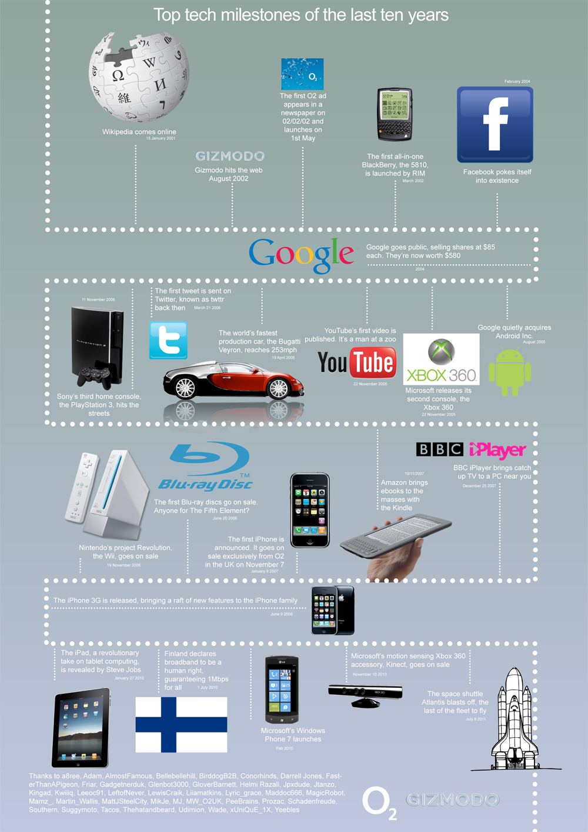
Near saturation of society by digital phenomena .
A fact of modern life, especially for OUR children…

Slide 5
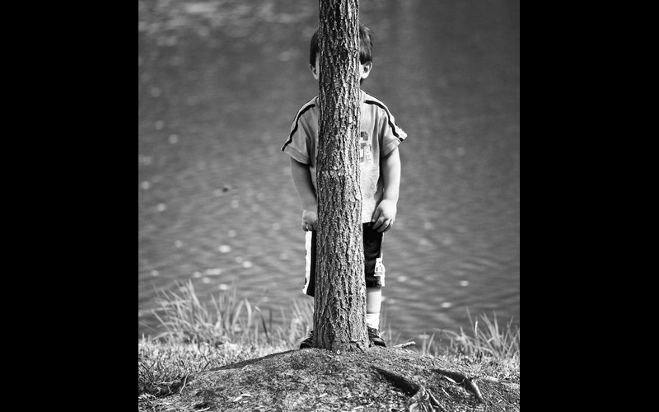
NO HIDING PLACE

Slide 6
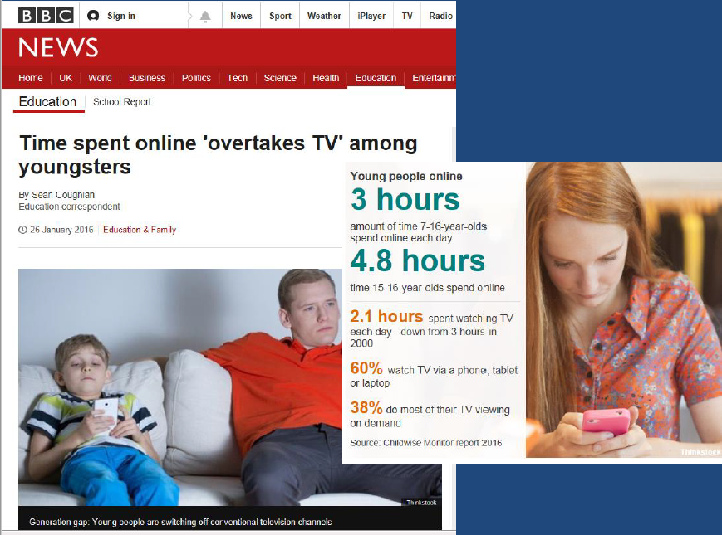
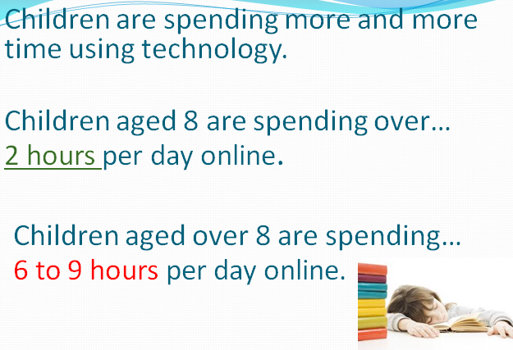

Slide 8
The benefits…
Enormous, free access to materials.
Engagement, supports interests.
Support for home learning.
Communication opportunities.
Develop key skills.

Slide 9
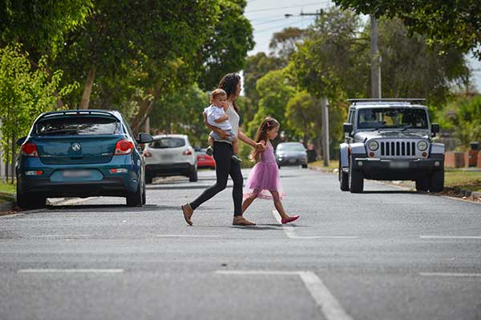
Risk Vs Benefit
How do we manage risks?
https://www.childrenscommissioner.gov.uk/publication/life-in-likes/
Notes:
Healthy habits
9

Slide 10
https://www.youtube.com/watch?v=CwT5PLBKEKk&safe=active

Slide 11
What we are doing…at school

Slide 12
Digital footprint

Slide 13
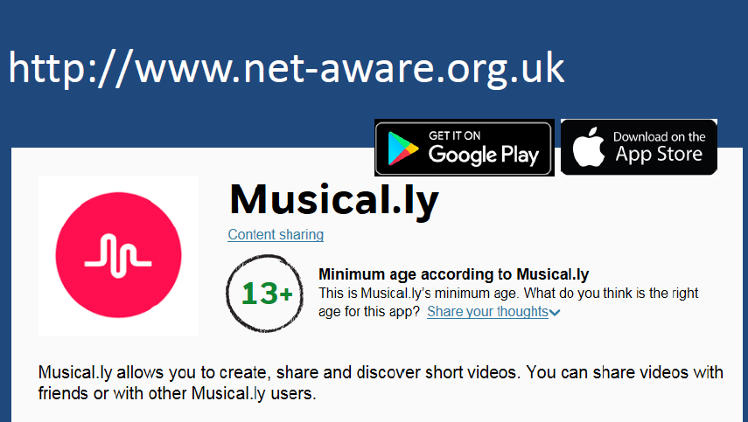

Slide 15
What do you do as a family?

Slide 19
https://www.youtube.com/watch?v=9scm3NCIH_E&safe=active

Slide 20
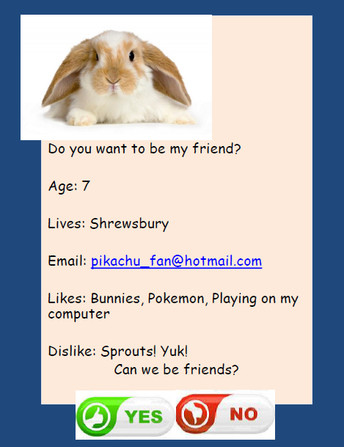

Slide 21
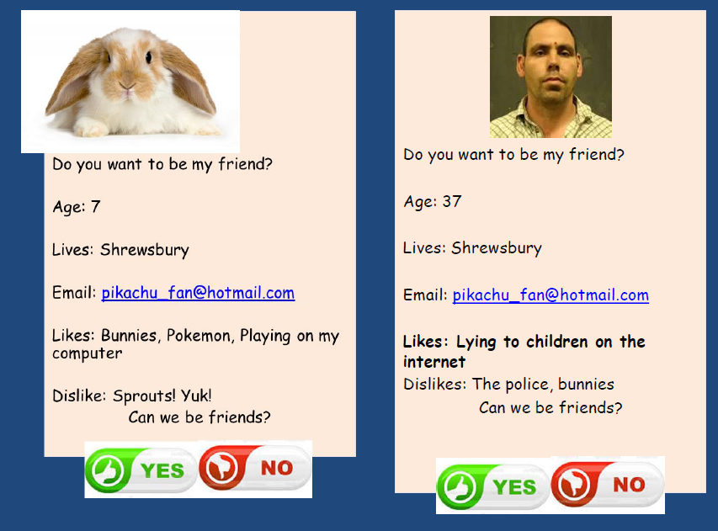

Slide 22
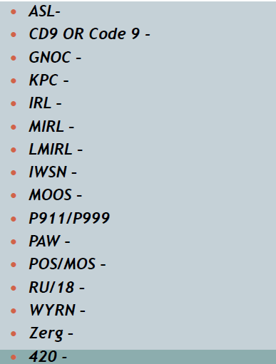
How many of these acronyms do you know?

Slide 23
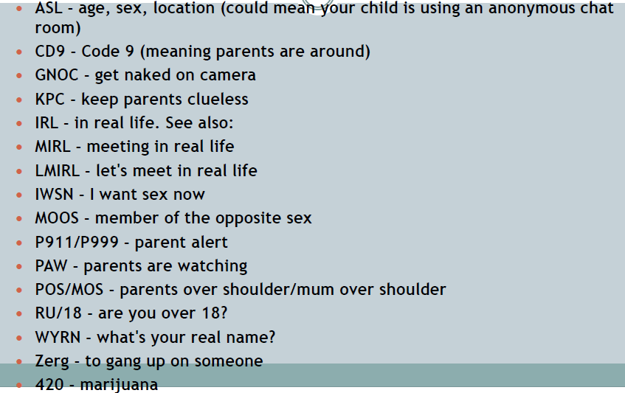
How many of these acronyms do you know?

Slide 24
https://www.youtube.com/watch?v=gGIDHrYKJ2s&safe=active

Slide 25
The Snowball Effect.

Slide 26
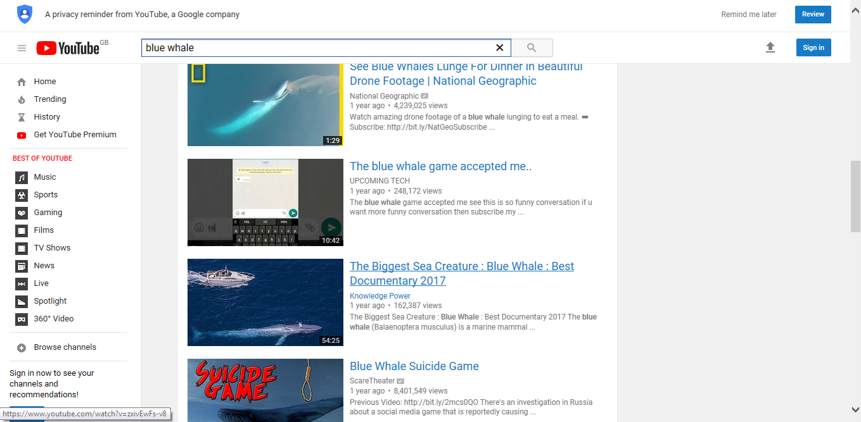
You Tube

Slide 27
